Slide 1
FRB Update #27
William Huang
07/26/2021

Slide 2
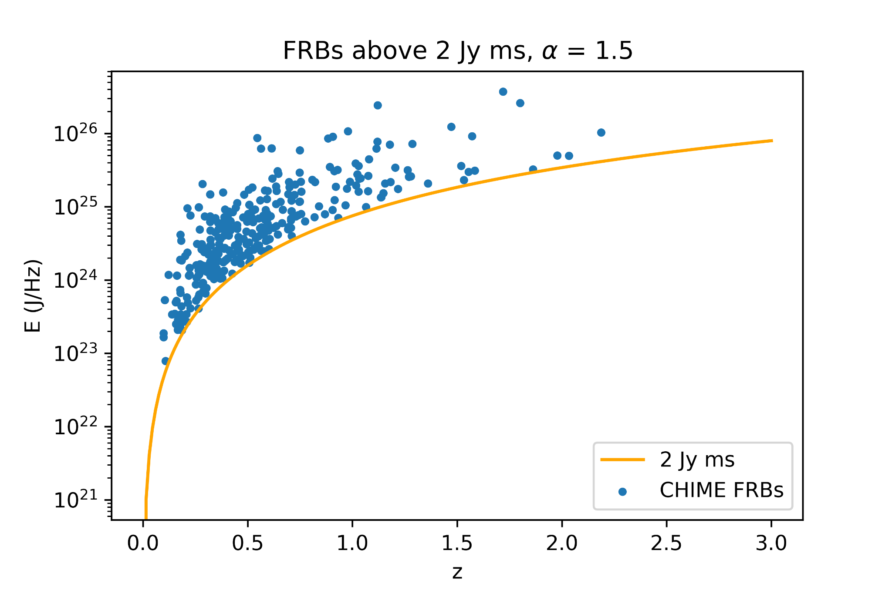
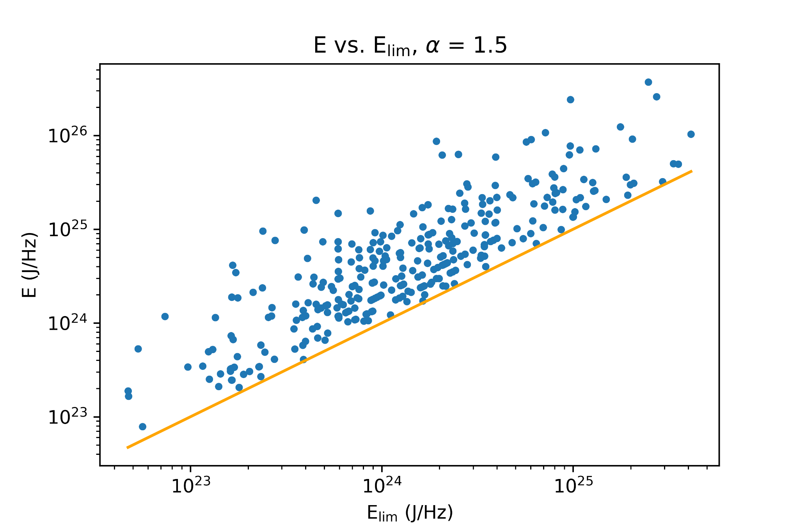
CHIME FRB Graphs
Below are graphs of E vs. z and E vs. E_{lim} using a limit of 2 Jy ms, alpha = 1.5, and repeaters excluded.

Slide 3
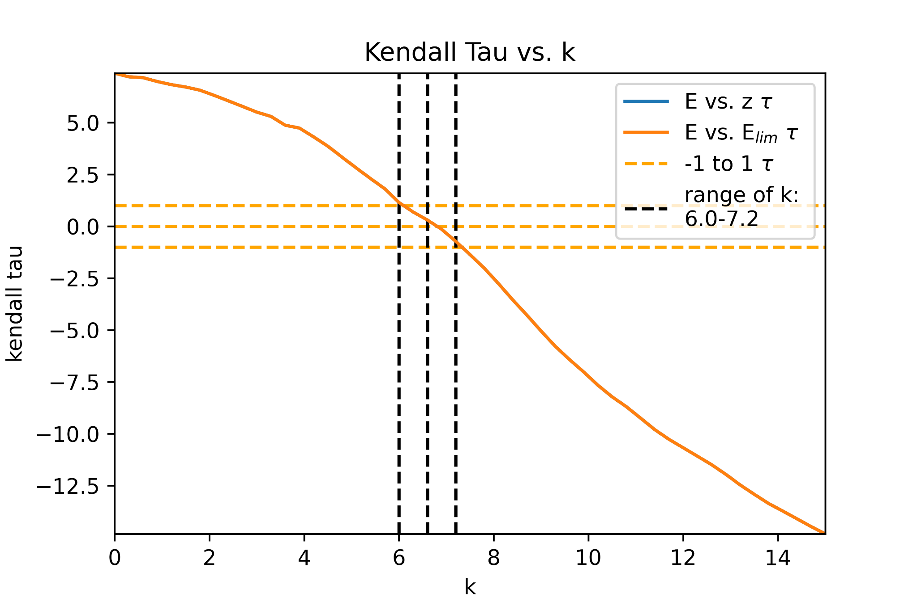
Kendall Tau
Using a function g(z) = (1+z)^{k}, I performed kendall tau over multiple values of k to find where E’ is independent of z. Both E vs. z and E vs. E_{lim} give the same results, which give independence at around k ~ 6-7, which seems too high.

